Slide 1
Charger Active Shield - Adversarial Attack Tool Defense
Noah Sickels, Adam Brannon, William Lochte
MENTOR: Dr. David Coe
CPE 488: Cybersecurity Engineering Capstone I
Electrical and Computer Engineering The University of Alabama in Huntsville
email: ncs0016@uah.edu, ajb0093@uah.edu, wpl0001@uah.edu

Slide 2
Background Information
Active Defense: Defending a system by directly interacting with the adversary while attack is in progress.
Attacking Application: The program the adversary is using to attack your system.
Active Defense Response: The response that the victim computer gives the attacking application; often sent as a network packet.
Note:
Attacking applications often exploit vulnerabilities within a program on the victim’s system.
What would happen if we instead exploited vulnerabilities in the attacking application?

Slide 3
Stalling Attacker’s Tools
Modern Tools are Efficient: Attackers can send hundreds to thousands of requests per minute or spread attacks over days to avoid detection.
Active Defense: Implementing mechanisms that neutralize attacks can waste attackers' time and resources.
Useful for all businesses with information to protect.
Counterattack: In legal scenarios, it could be useful to use binary exploitation to install malware on the attacker’s computer.
Could be useful in a nation-state scenario.

Slide 4
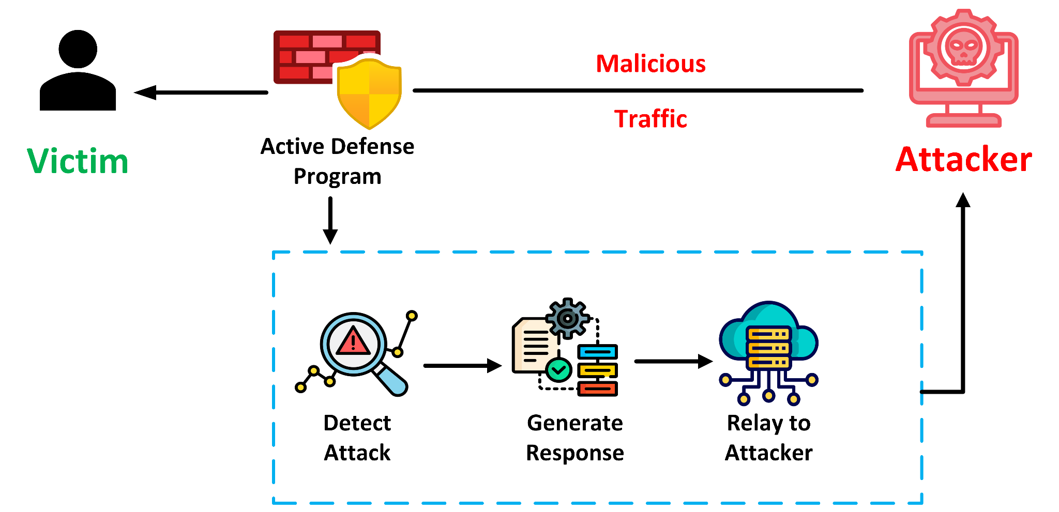
Charger Active Shield Overview

Slide 5
Related Research/Projects
AutoFuzz:
Framework for automatically testing and fuzzing network protocols for implementation flaws. [1]
Relevancy: We need to fuzz test networks protocols. AutoFuzz could be helpful.
LSSM:
AI/ML to actively resist deductive attacks from network traffic analysis. [2]
Relevancy: As part of our marketing requirements we must use AI or machine learning to generate network responses that crash/hang the attacking application. The LSSM paper might help with this.
[1] Gorbunov, Serge, and Arnold Rosenbloom. "AutoFuzz: Automated Network Protocol Fuzzing Framework." IJCSNS 10.8 (2010): 239.
[2] Z. Zhou, X. Kuang, L. Sun, L. Zhong and C. Xu, "Endogenous Security Defense against Deductive Attack: When Artificial Intelligence Meets Active Defense for Online Service," in IEEE Communications Magazine, vol. 58, no. 6, pp. 58-64, June 2020, doi: 10.1109/MCOM.001.1900367.
Notes:
EkHunter:
Automatically detects presence of web-based exploit vulnerabilities, and derives test cases to compromise integrity of exploit kit and even kit operator.

Slide 6
Related Research/Projects
EkHunter:
Automatically detects presence of web-based exploit vulnerabilities, and derives test cases to compromise integrity of exploit kit and even kit operator. [1]
[1] Eshete, Birhanu, et al. "EKHunter: A Counter-Offensive Toolkit for Exploit Kit Infiltration." NDSS. 2015. http://dx.doi.org/10.14722/ndss.2015.23237.

Slide 7
Related Patents
“Detection of Anomalies, Threat Indicators, & Threats to Network Security”, Splunk
Methodology for detecting anomalies in activity on a computer network by processing, using a plurality of machine-learning anomaly models to identify, generate, and process anomaly data. [1]
Automated Analysis using Sandbox & Machine Learning Classification Veracode Inc.
Methodology for automated behavioral and static analysis using a sandboxed environment and machine learning detection. [2]
[1] Splunk Security Platform, Sudhakar Muddu, Christos Tryfonas, 2019, ID: US20190342311A1
[2] Veracode Automated Analysis Methodology, Theodora H. Titonis, Nelson R. Manohar-Alers, Christopher J. Wysopal, 2017, ID: EP2610776B1

Slide 8
Related Products
Market and competition primarily consists of two main categories:
IDS/IPS Solutions
Suricata, OISF
Easy to use, Customizable, Direct rule feeds, Partially Free/Open-Source
EDR Solutions
CrowdStrike Falcon, CrowdStrike
Broad OS support, 24/7 Support Service, $99-$185/Device per month

Slide 9
Marketing Requirements
M1 | Workflow must prioritize attack tools that are more likely to have vulnerabilities.
M2 | Existing vulnerabilities of all six possible attack tools must be documented.
M3 | Must identify and select two attack tools to test on.
M4 | Software fuzzing tools capable of testing both attack tools must be identified.
M5 | Demonstrate a fuzz testing workflow for selected attack tools.
M6 | Proof of concept must show that the workflow functions.
M7 | Proof of concept program must provide an active defense response.
M8 | Proof of concept program must use AI/LLM to generate responses to interact with the attack tools.
M9 | Evaluate the performance of any active defense responses found.
M10 | Findings must be documented in an IEEE/ACM-style paper.

Slide 10
Engineering Requirements
Marketing Requirements | Engineering Requirements
M1 | E1: Workflow must prioritize tools that are at least 30% C/C++ or have memory errors found during static analysis.
M1, M3 | E2: Must use LDRA static analysis and Valgrind memory leak analysis on both selected attack tools for present vulnerabilities or more favorable testing targets.
M4 | E3: Must develop a fuzzing workflow using three fuzzing tools and approaches and ranking them based on probability of success with selected attack tools.
M1, M5, M6 | E4: Must demonstrate fuzzing workflow on both selected attack tools.
M5, M6, M7 | E5: Workflow must find at least one exploitable vulnerability (crash or hang) within the attacking application.
M7, M8 | E6: Must test two AI/LLMs for creating the active defense responses.
M9 | E7: The effectiveness of the responses to cause a hang or crash in the attacking applications must be evaluated and saved.
M10 | E8: Must compile rationale for attack tools, fuzzing tools, compatibility results and analysis for testing into an IEEE conference paper using proper formatting with font type, size, headers, and two columns per page.

Slide 11
Engineering Requirements
Engineering Requirement | Relation to Test Plan
E1 | The tools to select from must have higher percentage C/C++ source files, present on their respective repository pages for written language breakdown.
E1, E2 | Review LDRA static analysis “All Metrics” Quality Review score for lower scores across the six potential attack tools. Review the Valgrind “all-checks” memory leak detection for highest memory leak/bytes lost from each tool.
E3 | Test three fuzzing tools selected during the screening process and check compatibility with both selected attack tools (Medusa and Masscan) and test one new fuzzing tool during each reporting period. The other three fuzzing tools will be used as alternatives if issues arise with initial tools.
E4 | Once developed fuzzing workflow is complete after all fuzzing tools verified either compatible or not, show functionality of fuzzing workflow on Medusa and Masscan and let run for at least one full day.
E5 | During demonstration of fuzzing workflow of Medusa and Masscan, if we do not find hangs or crashes on either after one full day, we will let it run until it finds one, or end of semester.
E6 | During second phase of project, research and select two models/types of AI/LLM to use for the active defense response Python program.
E7 | Once crashes or hangs are found, configure AI/LLM Python program to relay the responses to the attacking machine once incoming attack detected on the network.

Slide 12
Proposed Solution
Our solution offers a structured workflow for testing adversarial attack tools by identifying responses that may cause them to crash or become unresponsive. This solution consists of several key components: the attack tools, the fuzzing tools, the attacking virtual machine (VM), and the victim virtual machine (VM).
For the attack tools, we had six potential candidates to test against, including Medusa, Masscan, Reaver, Aircrack-ng, Yersinia, and Netdiscover.
For the fuzzing tools, we tested the compatibility of six in total with Medusa and Masscan: AFLnet, Fuzzowski, Scapy, Radamsa, Randpkt, and Peach Fuzzer.

Slide 13
Proposed Solution
In the end, we selected Medusa and Masscan attack tools due to their extensive support for various protocols, lower LDRA scores, and higher instances of memory leaks found in initial testing.
For fuzzing tools, we selected AFLnet, Scapy, and Radamsa to utilize going forward with the project.
Randpkt was excluded because it was a less robust version of Scapy and Radamsa.
Peach Fuzzer was considered too outdated and presented too many installation problems to be reliable.
We will focus primarily on real-time protocol fuzzing, with fuzzed network packet generation being an alternative.
Real-time protocol fuzzing is more difficult to manage but provides more accurate results as to how the attack tool would react.

Slide 14
Proposed Solution
Real-time protocol fuzzing benefits:
More accurate results of how Medusa and Masscan will react to fuzzed network traffic.
Less overhead, as the wrapper would handle the fuzzing automatically without the need for supervision.
Drawbacks:
Requires more resources to efficiently run (virtual machines running the fuzzing; slower CPU = slower executions per second)
Slower runtime overall
Fuzzed Pcap benefits:
Scriptable to generate the random data packets and can be run numerous times to get different results each pass.
Easier to set up and run.
Drawbacks:
Less accurate of how the tools would react to the network traffic as they are not interacting directly with the victim machine.
Requires you to manually re-generate the fuzzed files each time for new test cases.
Not innately configured to manage the iterations/packets currently under test, saving found hangs or crashes, etc. and would require additional programmed behavior first.
We decided to choose real-time protocol fuzzing, as it would be more autonomous and more accurate for thorough fuzz testing.

Slide 15
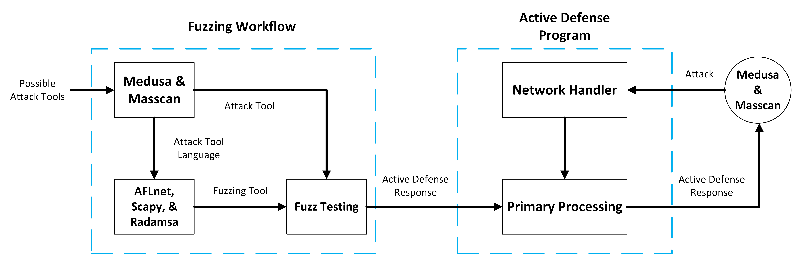
Functional Decomposition

Slide 16
Functional Decomposition
Module | Fuzzing Workflow
Inputs | Attack tools, fuzzing tools
Outputs | Found crashes or hangs
Functionality | Run fuzzing tools on attack tools network traffic while in use on the target machine. Report and save any crashes or hangs within the attack tool.
Module | Active Defense Program
Inputs | Network packets
Outputs | Network packets
Functionality | Take in network packets from the victim machine. Detect if the traffic is from an attack tool. Return active defense response packets.
Module | Adversarial Attack Tool
Inputs | Network packets
Outputs | Network packets
Functionality | Connect to victim machine on network. Send malicious network packets. Take in response network packets.
Module | Target Machine
Inputs | Network packets
Outputs | Network packets
Functionality | Take in network packets and pass them to the Python service. Send out network packets from the Python service.

Slide 17
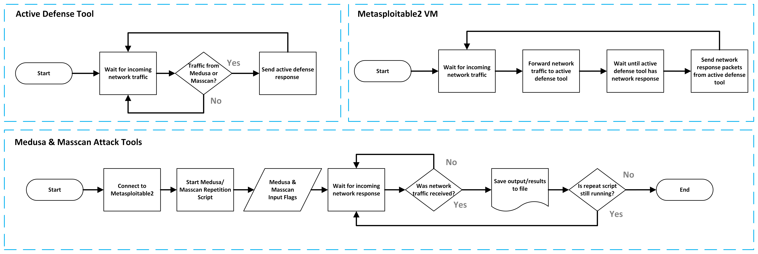
Behavioral Decomposition

Slide 18
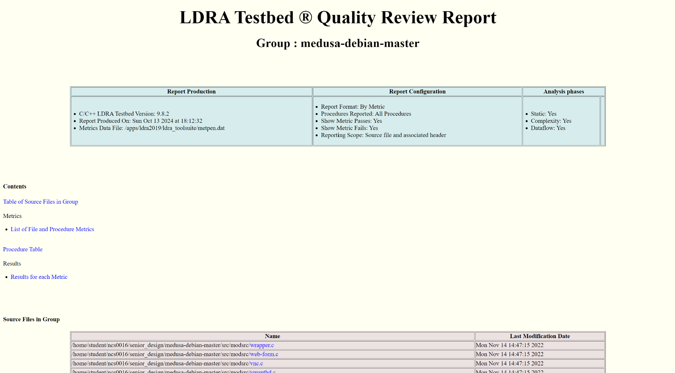
Current Functionality of the Project
LDRA Static Analysis & Valgrind Memory Leak Checking
LDRA static analysis & Valgrind run against all six attack tools: Medusa, Masscan, Reaver, Aircrack-ng, Yersinia, and Netdiscover.
Medusa & Masscan chosen for attack tools.
Performed compatibility testing of each selected fuzz tools on both attack tools.
Compatible: AFLnet, Fuzzowski, Scapy + Radamsa.
Incompatible: Peach Fuzzer.
Notes:
What has been accomplished in your project so far?

Slide 19
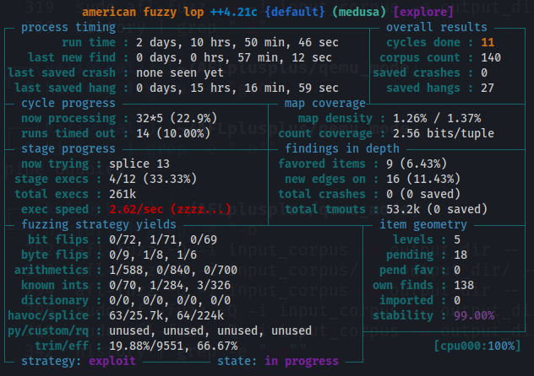
Current Functionality of the Project
Selected our fuzz testing tools based on two methods of approach:
(1) Real-Time Protocol Fuzzing Using AFLnet (AFL++)
We were successfully able to get both Medusa and Masscan to work with AFLnet, allowing us to test the protocol and port while the programs are in use against the target machine.
(2) Generating Fuzzed Network Traffic in Pcap File Format Using Scapy & Radamsa
Medusa and Masscan take pcap files as input to perform their designated function.
Radamsa would be used to create the random test cases, while Scapy would package it into packets to save into a packet capture file.
Radamsa also supports real-time protocol fuzzing as well, and can be used as a backup if issues arise with further AFLnet testing.
Notes:
What has been accomplished in your project so far?

Slide 20
Expected Additional Functionality of the Project
Compile all written reports into IEEE-style conference paper, including the reports for our chosen attack tools, fuzzing tools, and results of this semester’s efforts.
Apply our fuzzing workflow to our attack tools Medusa and Masscan.
Test and improve the workflow from the results of our initial fuzzing.

Slide 21
Lessons Learned
Fuzzing networks are far more difficult than we initially believed.
The dynamic nature of networking makes it difficult to create stable test environments without outside interference.
Documentation is not always accurate, or up-to-date.
Just because it is owned by an established brand/company, does not mean it is a perfect product (Peach Fuzzer).
Communication between group members is paramount, and must be consistent, and frequent to minimize wasted efforts and confusion.
There are a wide variety of available fuzzing tools that can all differ in approach and use cases; some niche, some broad.
Notes:
What did you learn working on your project?
What activities were more complicated than expected? And what were easier than expected?
Other lessons learned?

Slide 22
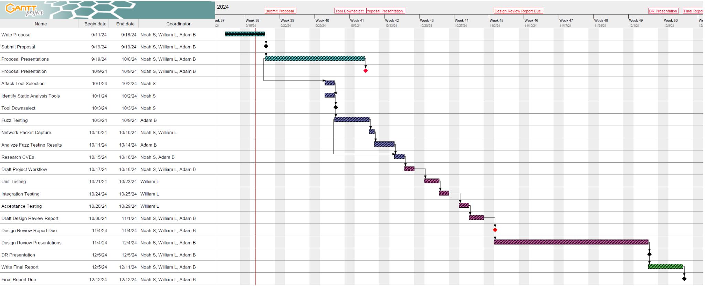
Original Timeline

Slide 23
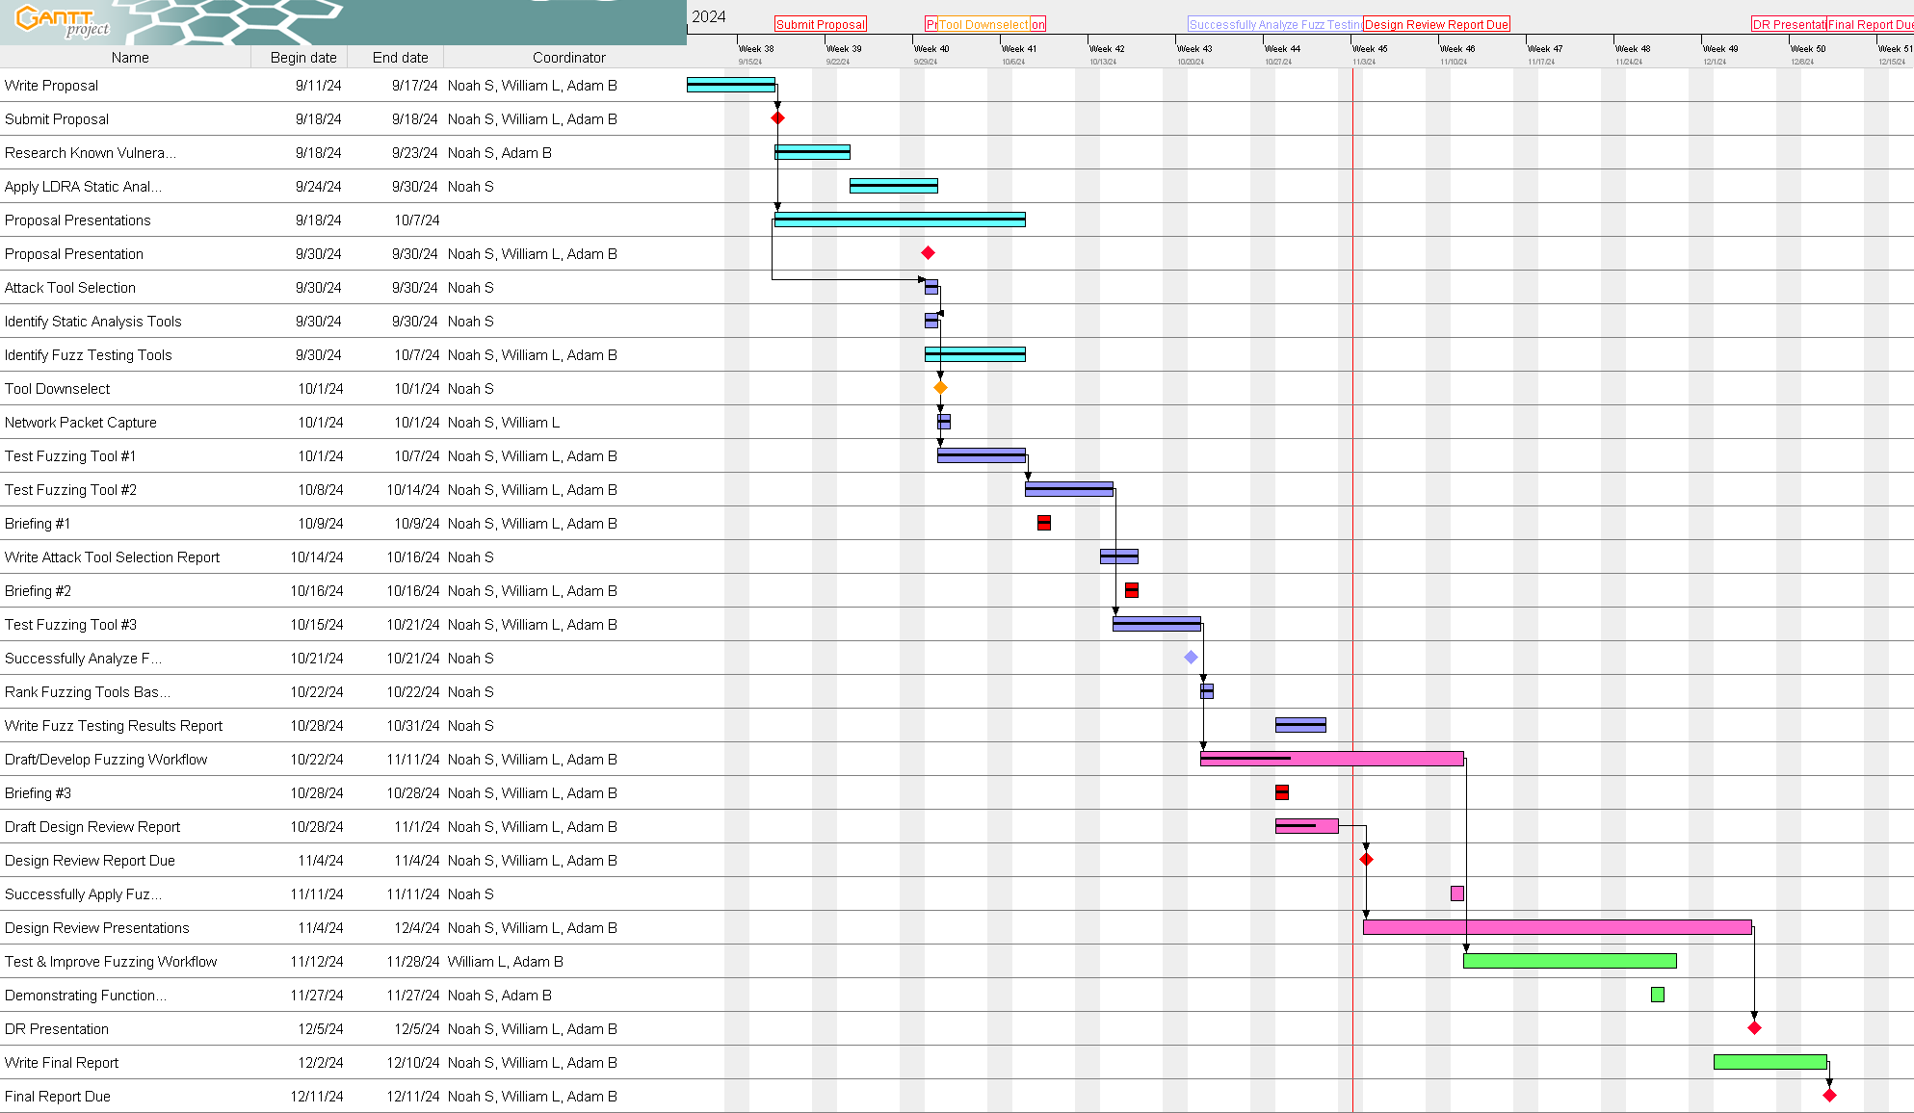
Actual Timeline

Slide 24
Missed Milestone Dates
Milestone/Task | Projected Date | Actual Date
Identify Fuzz Testing Tools | 9/30 | 10/7
Analysis of Fuzz Tool Compatibility Results | 10/27 | 10/30
Rank Fuzz Tools by Likelihood of Success | 10/27 | 10/30
Future mitigations for meeting milestones on time:
Ensure individual responsibility through regular status updates every two days from each group member.
Make certain that each member is aware of the tasks and responsibilities assigned to them for the respective period.
Notes:
From original timeline

Slide 25
Proposed Member Contributions
Activity | Assigned Person(s)
LDRA Static Analysis / Pre-screening | Will
Background Research on CVEs/Weaknesses | Adam, Will
Identify Attack Tools and Fuzzing Tools | Noah, Will
Attack Tool Network Traffic Capture | Adam, Noah
Tool #1: AFL/AFL++ Compatibility Testing | Adam, Noah, Will
Tool #2: Fuzzowski Compatibility Testing | Noah, Will
Tool #3: Peach Fuzz / Scapy & Radamsa Compatibility Testing | Adam, Noah
Fuzz Compatibility Testing Results & Analysis | Adam, Noah

Slide 26
Actual Member Contributions
Activity | Assigned Person(s)
LDRA Static Analysis / Pre-screening | Noah
Background Research on CVEs/Weaknesses | Noah
Identify Attack Tools and Fuzzing Tools | Noah, Will
Attack Tool Network Traffic Capture | Noah
Tool #1: AFL/AFL++ Compatibility Testing | Adam, Noah, Will
Tool #2: Fuzzowski Compatibility Testing | Noah
Tool #3: Peach Fuzz / Scapy & Radamsa Compatibility Testing | Adam, Noah
Fuzz Compatibility Testing Results & Analysis | Adam, Noah

Slide 27
Individual Responsibility / Level of Effort
Reporting Period | Noah | William | Adam
Brief 1 | 56 | 14 | 16
Brief 2 | 22 | 13 | 10
Brief 3 | 30 | 0 | 32
Design Review | 36 | 7 | 18
Total (work/hours) | 144 | 34 | 76
Original Estimated Labor Cost: 150 hours/person, 450 hours total
Actual Total Labor Cost: 84 hours/person, 254 hours total

Slide 28
Individual Responsibility: Noah
Reporting Period | Task/Accomplishment | Related Milestone(s)
Brief 1 | Finish project proposal presentation slides. | Project Proposal Presentation
 | LDRA and Valgrind static analysis of all attack tool candidates. | Apply LDRA static analysis & Valgrind on all attack tools.
 | Background research of any known vulnerabilities and CVEs. | Background Research for CVEs & Exploits
 | Attack tool selection from list of candidates. | Attack Tool Selection
 | Identify fuzz testing tools to use for each period. | Identify Fuzz Testing Tools
 | Capture of unaltered network traffic of Medusa and Masscan against target VM. | Network Packet Capture on Medusa & Masscan
 | Aflnet configuration and viability testing against Medusa and Masscan. | Test Fuzzing Tool #1

Slide 29
Individual Responsibility: Noah
Reporting Period | Task/Accomplishment | Related Milestone(s)
Brief 2 | Fuzzowski configuration testing against Medusa and Masscan - including repetition script and custom POC FTP module. | Test Fuzzing Tool #2
 | Updated general configuration information on attack tool(s), kernel, and gcc compiler versions for reporting and documentation. | Design Review Final Report
Brief 3 | Peach Fuzz configuration and viability and compatibility for use with Medusa and Masscan. | Test Fuzzing Tool #3
 | Written attack tool selection report for rationale of tools used for the project. | Design Review Final Report
 | Written fuzz tool selection report for rationale of tools used for the project. | Design Review Final Report
 | Analysis of fuzz tool compatibility results on Medusa and Masscan. | Analyze Fuzzing Tool Results

Slide 30
Individual Responsibility: Adam
Reporting Period | Task/Accomplishment | Related Milestone(s)
Brief 1 | Finish project proposal presentation slides. | Project Proposal Presentation
 | Research on fuzz testing using simple and smart fuzzers. | Identify Fuzz Testing Tools
 | Setup and testing of AFL++ for use with Medusa and Masscan. | Test Fuzzing Tool #1
Brief 2 | Draft report for attack tool selection. | Identify Attack Tools
 | Continue setup and configuration of AFL++/AFLnet | Test Fuzzing Tool #1
Brief 3 | Configured Scapy with Python script to send packets to Medusa through the FTP module. | Test Fuzzing Tool #3

Slide 31
Individual Responsibility: William
Reporting Period | Task/Accomplishment | Related Milestone(s)
Brief 1 | Finish project proposal presentation slides. | Project Proposal Presentation
 | Research on existing projects surrounding network-based fuzzing. | Project Proposal Presentation
 | Research on potential network-based fuzz testing tools. | Identify Fuzz Testing Tools
Brief 2 | Exploration of backup attack tool - Reaver - and available fuzzing options for it; Configuration and setup of Reaver for pcap file ingest. | Test Fuzzing Tool #2
Brief 3 | Nothing. | N/A

Slide 32
Contingency Plan
If one member does not deliver, we split their responsibilities between the rest of the group.
If the workload is too much for only two remaining members, or if more than one member does not deliver, focus will be placed on one attack tool for that period, rather than two.
Testing will continue to be conducted using the fuzz tool for that period as originally planned.
If we are unable to meet in person for any reason, we will utilize online communication through Discord or Zoom.

Slide 33
Conclusions
Attackers today utilize highly efficient tools that can send hundreds or even thousands of requests per minute, or they may transmit packets infrequently over several days to evade detection.
Our solution provides an active defense mechanism that directly targets attackers by dispatching data packets designed to slow down or crash the attacker's application.
This approach is an innovation on traditional, reactive methods of defending against incoming attacks, as it aims for real-time protection.
We have examined six different fuzzing tools against our two attack tools and plan to conduct more thorough testing as we move into the second semester.
Notes:
Describe the problem and the solution
What is innovative in your project?
What has been accomplished?
What is expected impact of your project?

Slide 34
Additional Slides

Slide 35
Engineering Requirements
Marketing Requirements | Engineering Requirements
M2 | E9: Search MITRE CVE and Exploit-DB databases and compile known vulnerabilities for all six possible attack tools.
M6, M7 | E10: Proof of concept Python service must be developed to identify incoming attack tool network packets/traffic.
M6, M7 | E11: Proof of concept Python service must send active defense responses within one second of detection of incoming attack.

Slide 36
Engineering Requirements
Engineering Requirements | Relation to Test Plan
E9 | Perform background research on all six attack tool candidates using MITRE, NVD, and Exploit-DB databases for relevant existing weaknesses and vulnerabilities.
E10 | Python program will be developed to attach to network adapter between host VM and target VM so that incoming traffic is sent through the Python service directly, where the AI/LLM will make the determination of malicious or benign traffic.
E11 | Once Python program detects incoming network traffic from attack tool, will send provided crash/hang responses found during thorough fuzz testing of each attacking application.

Slide 37
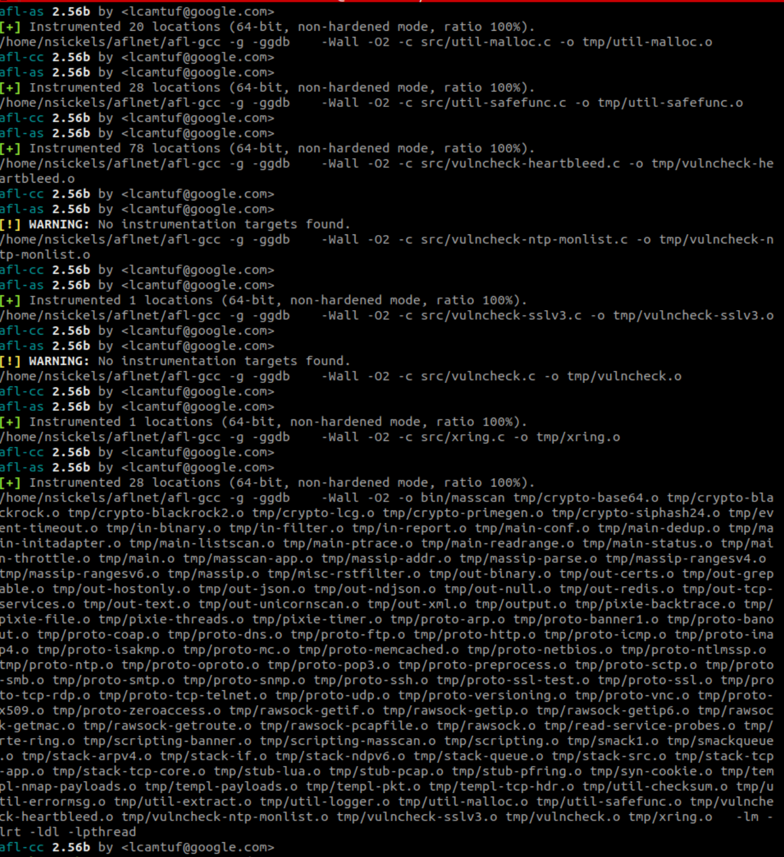
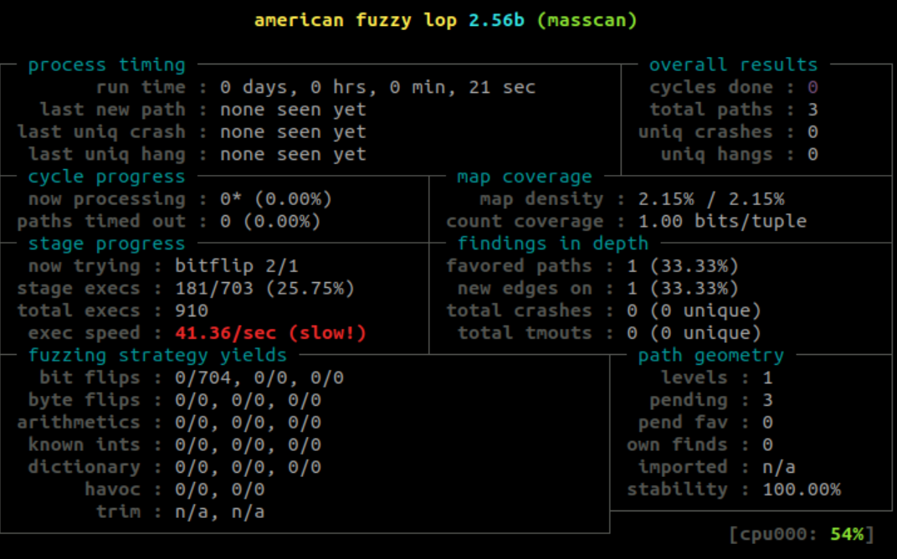
Functionality
Instrumented binary & compatibility testing on Masscan using AFLnet (AFL++)

Slide 38
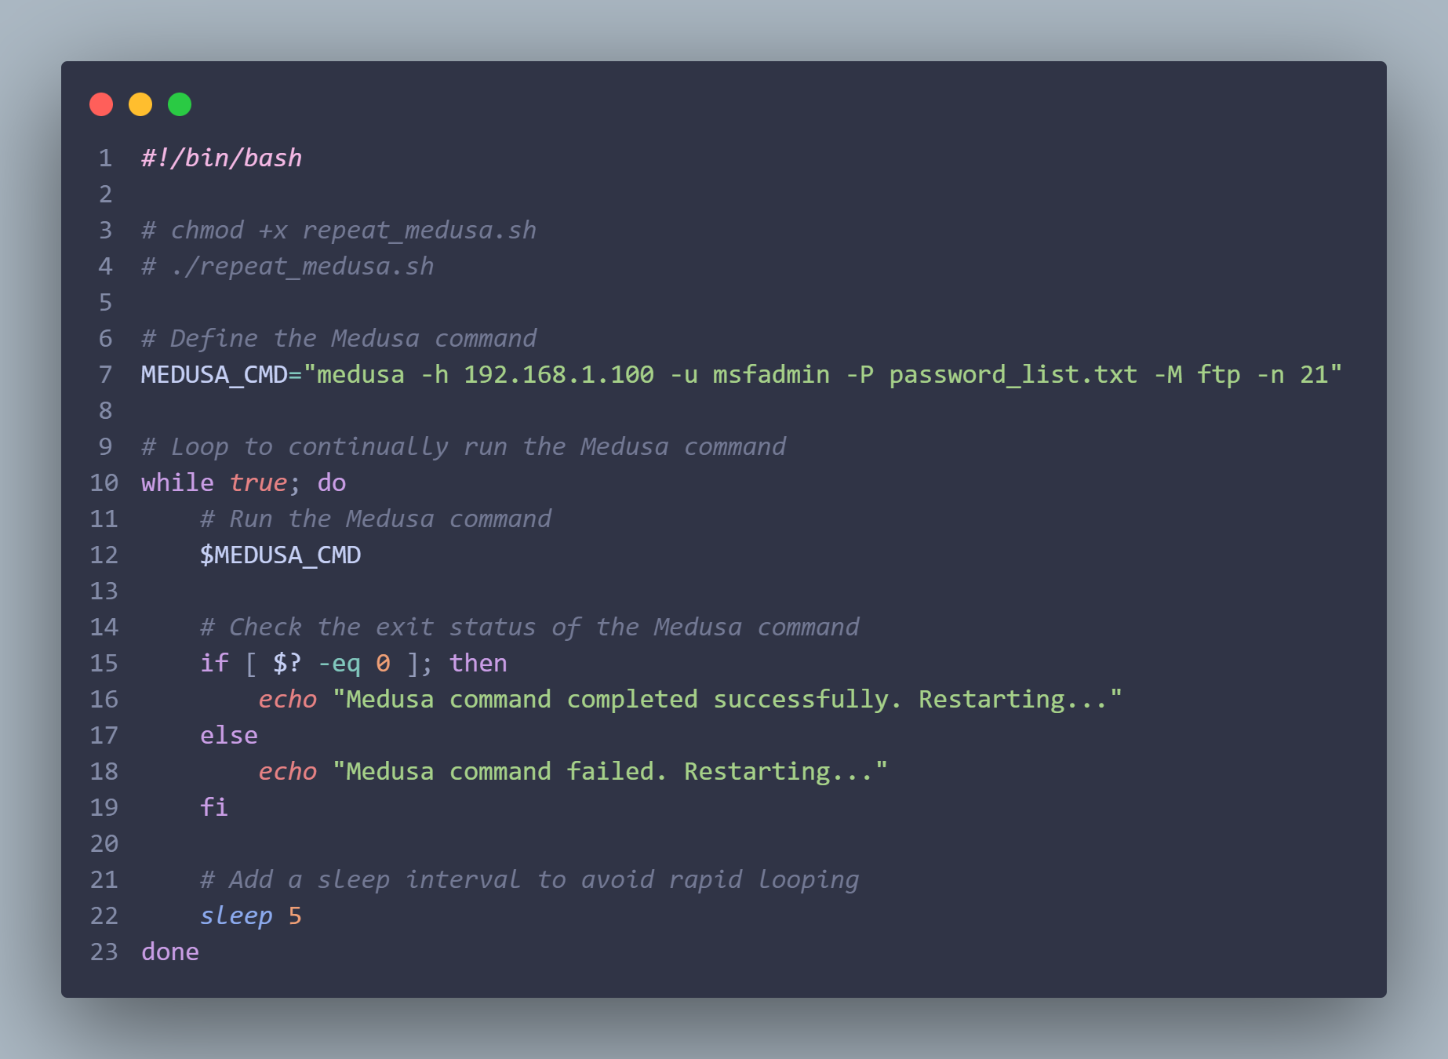
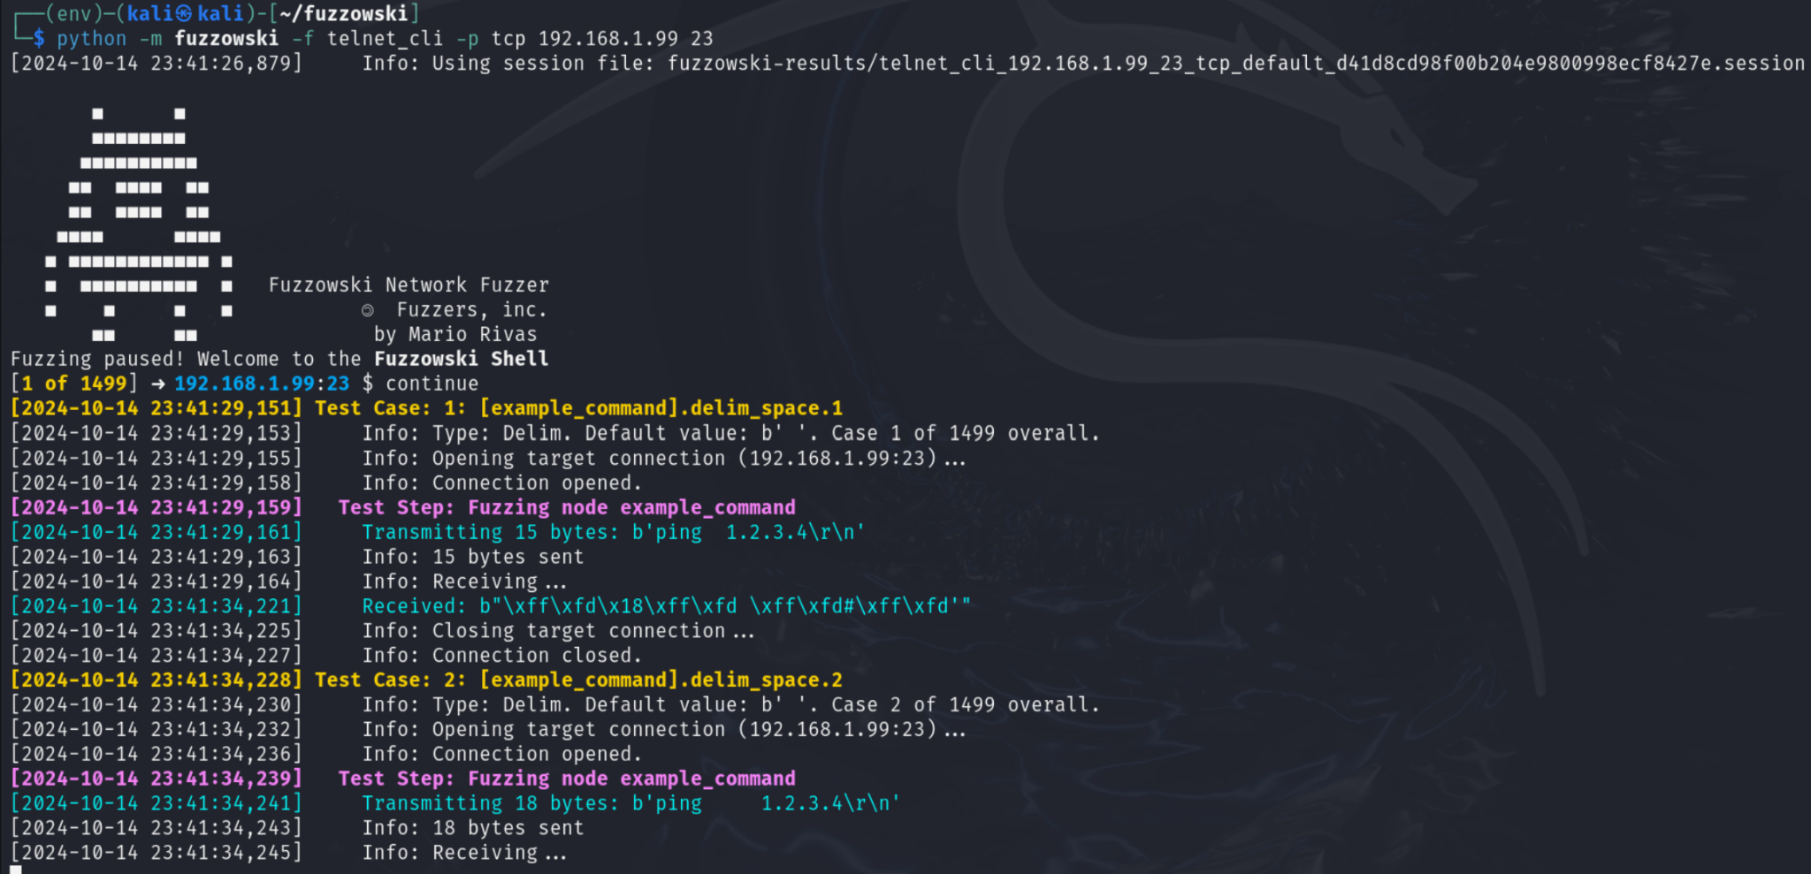
Functionality
Medusa repetition script for testing.
Fuzzowski configuration and compatibility testing on Medusa

Slide 39
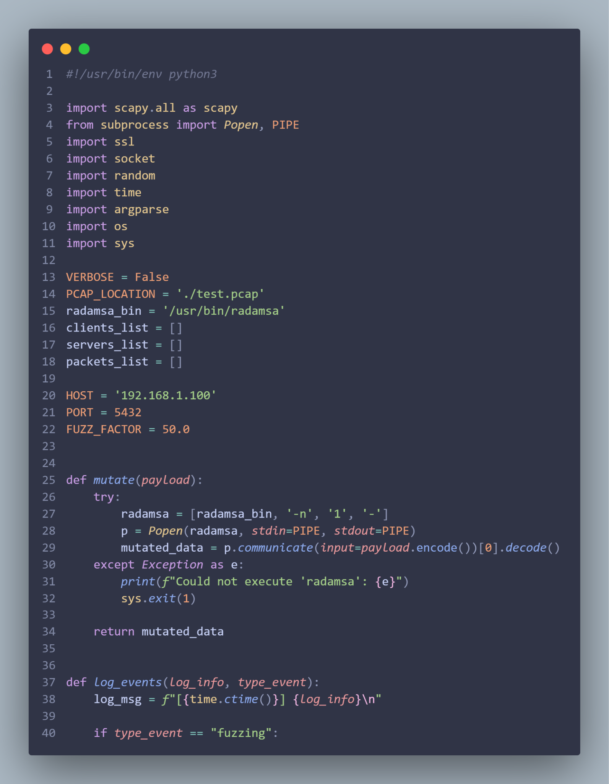
Functionality
Scapy & Radamsa Python script for generating fuzzed network packets and packaging them into pcap file format.

Slide 40
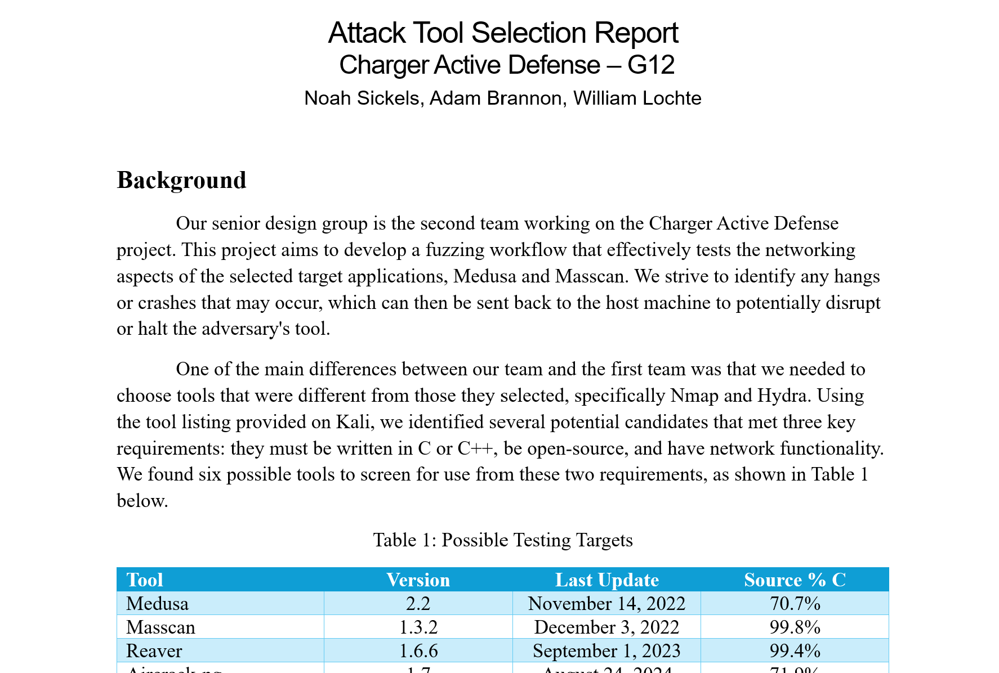
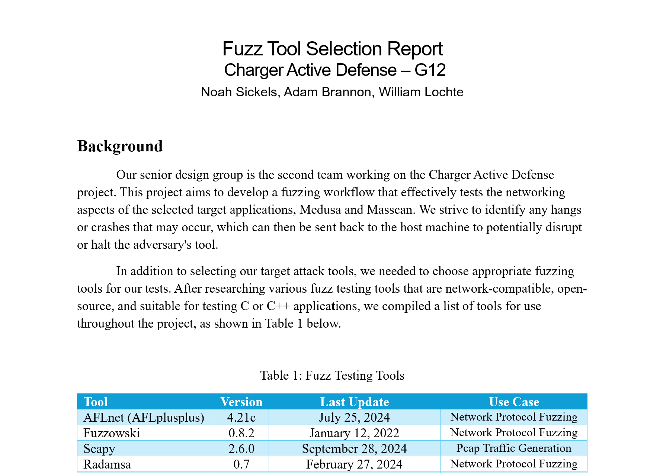
Functionality
Written reports for tool selection and results analysis.

